Slide 1


Slide 2

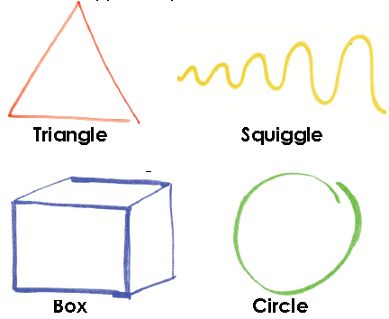
Shape Talk
Activity:
Go to the shape that you feel most connected to!
2. Complete the questionnaire

Slide 3
We can work effectively together with all styles, provided that three conditions exist:
  We have mutual respect
  We have mutual trust
  We are willing to adapt
Please split into the 4 shape groups, try and guess which shape group you belong to?

Slide 4
Activity
Please split into your shape groups and discuss/write up:
  My strengths
  My weaknesses
  How I like to communicate (talk to others)
  How I like to be communicated with (how others talk to me)

Slide 5
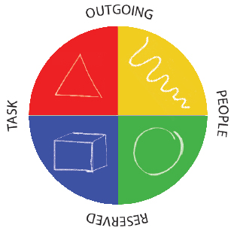
Shapes – Comparisons/Benefits

Slide 6
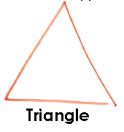

Driven, Decisive,
Decision makers
Positive
Focused
Goal oriented
Confident
High self esteem
Likes change
Takes charge
Takes risks
Competitive
Always finishes things
Negative
Intolerant
Sets very high standards
Perfectionist
Think they know best
Can be bossy and pushy
Tough
Fussy and demanding
Not very sensitive
Lacks listening skills

Slide 7
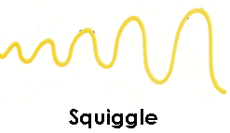
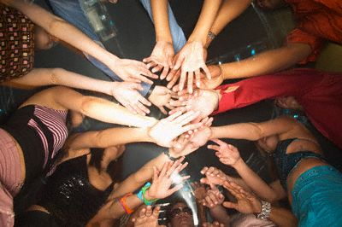
Excitable, Influential,
‘Ideas’ people, Animated
Positive
Enthusiastic
Entertaining
Excitement seeker
Funny
Likes to help people
Optimistic
Idealistic
Risk taker
Creative
Problem solver
Many ideas
Negative
Disorganised
Doesn’t follow things through
Fickle listener
Easily bored
Risk taker
Emotional

Slide 8
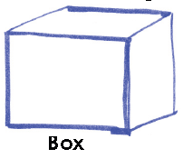
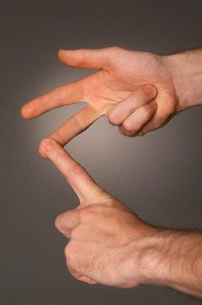
Analytical, Business-like,
Competent
Positive
Accurate
Critical thinker
Good planner
Fair
Orderly
Businesslike
Detail oriented
Takes time to make decisions
Relies on data
Negative
Perfectionist
Critical
Slow at making decisions
Structured
Formal
Less sensitive to others’ needs

Slide 9

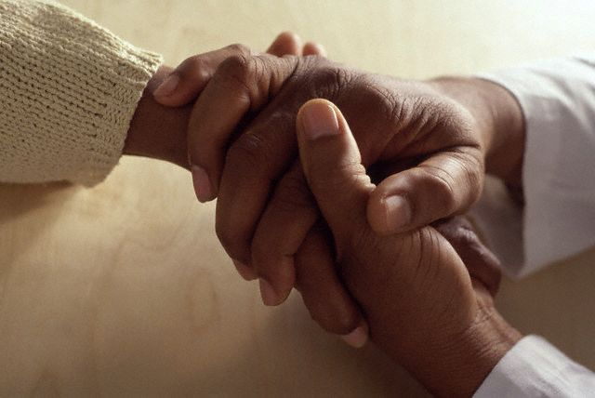
Loyal, Patient, Caring
Positive
Likes doing things for others
Loyal
Calming
Tolerant
Excellent listener
Sensitive to others
Empathetic
Warm
Patient
Nurturing
Sensitive
Negative
Hates conflict
Lacks assertive behavior
Submissive
Doesn’t take initiative
Slow decision maker
Self sacrificing
sensitive

Slide 10
Reflection
What are you going to stop doing?
What are you going to keep doing?
What are you going to do differently?

